Slide 1
Fundamentals -II
Lecture-3
Programming Fundamentals contd..
Prateek Narang

Slide 2
Any doubts?

Slide 3
Brain Teasers?

Slide 4
BT – 5: Circular Jail Cell
There is a circular jail with 100 cells numbered 1-100. Each cell has an inmate and the door is locked. One night the jailor gets drunk and starts running around the jail in circles. In his first round he opens each door. In his second round he visits every 2nd door (2,4,6---) and shuts the door. In the 3rd round he visits every 3rd door (3,6,9---) and if the door is shut he opens it, if it is open he shuts it. This continues for 100 rounds (i.e. 4,8,12 ---; 5,10,15 ---; ---; 49,98 etc.) and exhausted the jailor falls down.
How many prisoners found their doors open
after 100 rounds?

Slide 5
BT – 6: Greedy Pirates
A pirate ship captures a treasure of 1000 golden coins. The treasure has to be split among the 5 pirates: 1, 2, 3, 4, and 5 in order of rank. The pirates have the following important characteristics: infinitely smart, bloodthirsty, greedy. Starting with pirate 5 they can make a proposal how to split up the treasure. This proposal can either be accepted or the pirate is thrown overboard. A proposal is accepted if and only if a majority of the pirates agrees on it. What proposal should pirate 5 make?

Slide 6
BT – 7: Infinite Quarter Sequence
You are wearing a blindfold and thick gloves. An infinite number of quarters are laid out before you on a table of infinite area. Someone tells you that 20 of these quarters are tails and the rest are heads. He says that if you can split the quarters into 2 piles where the number of tails quarters is the same in both piles, then you win all of the quarters. You are allowed to move the quarters and to flip them over, but you can never tell what state a quarter is currently in (the blindfold prevents you from seeing, and the gloves prevent you from feeling which side is heads or tails). How do you partition the quarters so that you can win them all?

Slide 7
BT – 8: Daughters’ Ages
Local Berkeley professors Dr. X and Dr. Y bump into each after a long time.
X hey! how have you been?
Y great! i got married and i have three daughters now
X really? how old are they?
Y well, the product of their ages is 72, and the sum of their ages is the same as the number on that building over there
Y right, ok ... oh wait ... hmm, i still don't know
X oh sorry, the oldest one just started to play the piano
Y wonderful! my oldest is the same age!
How old are the daughters?

Slide 8
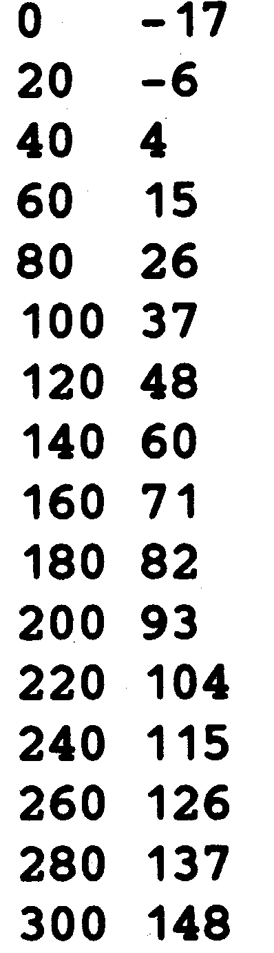

Warm up!
Write a program which takes initial value, final value and a step value and prints a table for Fahrenheit to Celsius using formula - C = (5/9)(F – 32)
E.g: For initial 0, final 300 and step 20 output is

Slide 9
Square root of a given number?
Notes:
Discuss multiple solutions
Find Nearest Integer and then use Long Division Method for fraction part
In each step increment by 0.0005 and keep checking
Newtons Rapson Method newx = oldx – (f(x)/f’(x))

Slide 10
Sizeof( ) operator ?

Slide 11
Constants
C++ has two types of constants
Literals
Integer [ 212, 215u,0x4b,077, 30ul, 75L)
Floating [3.14, 31459E-5]
Boolean [ true, false]
Character [ ‘a’, ‘\n’, ‘\t’, ‘\\’, ‘\’’ ]
String [ “Coding Blocks” ]
Symbolic Constants
#define preprocessor
const keyword

Slide 12
Type conversion!
Implicit – Based on the operator and operands
Explicit – (new type) expression
Notes:
(int) 2.0 + 3.5

Slide 13
Operators we have seen
Unary [ +, - ]
Arithmetic [ +, -, /, *, % ]
Brackets [ () ]
Assignment [ = ]
Relational [ ==, !=, >, <, >=, <=]
Logical Operators [ &&, ||, ! ]
PS - 1: Relational Operators and Logical Operators always Evaluate to 0 or 1
PS – 2: For logical evaluation any non-zero value is true.
PS - 3: Evaluation of a logical expressions stops as soon as the final value is known.

Slide 14
Some more operators!
Arithmetic – [ ++ , -- ]
Bitwise Operators – [ &, | , ~, ^, <<, >>]
Compound assignment operators – [ +=, *=, /=, %=, &=, |=, ^=, <<=, >>= ]
Notes:
++ , -- don’t apply to any expression. They need a memory storage!
~ is a unary operator [ one’s complement ]

Slide 15
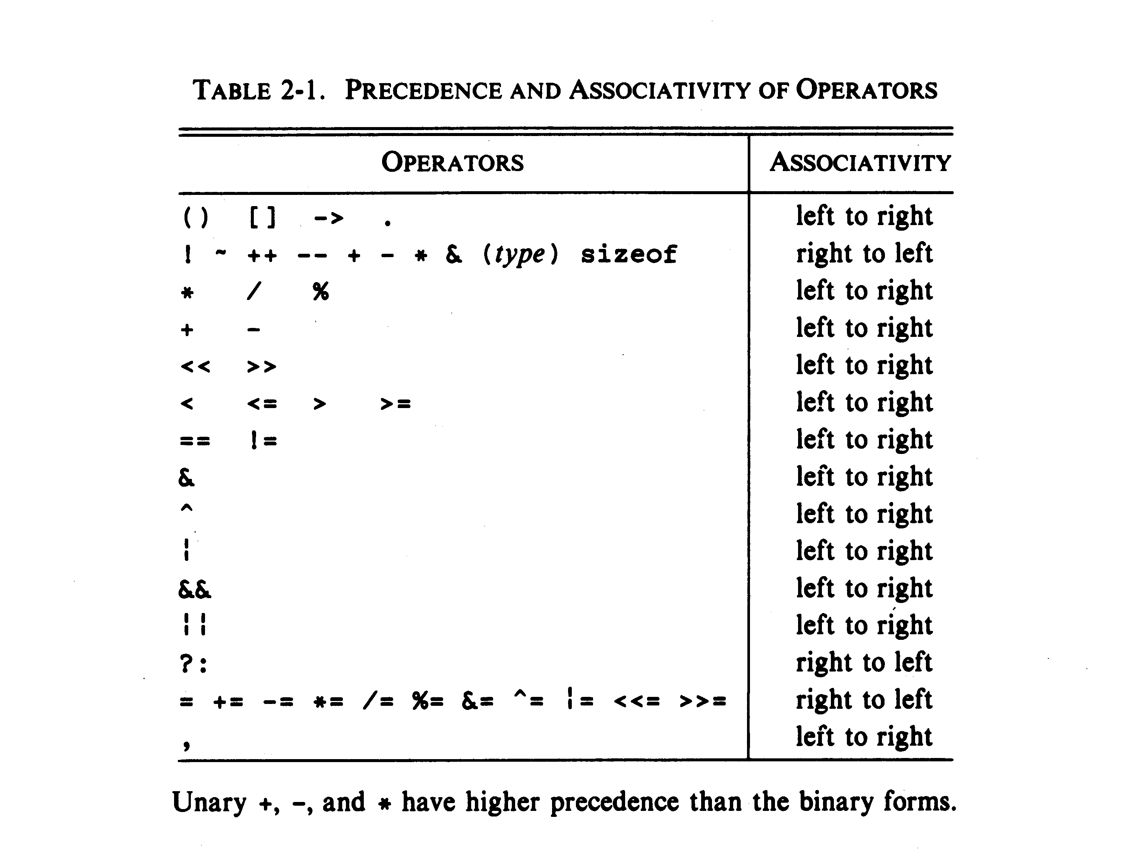

Precedence & Associativity
Notes:
Operator precedence determines which operator is performed first in an expression with more than one operators with different precedence. For example 10 + 20 * 30 is calculated as 10 + (20 * 30) and not as (10 + 20) * 30.
Associativity is used when two operators of same precedence appear in an expression. Associativity can be either Left to Right or Right to Left. For example ‘*’ and ‘/’ have same precedence and their associativity is Left to Right, so the expression “100 / 10 * 10″ is treated as “(100 / 10) * 10″.
Precedence and Associativity are two characteristics of operators that determine the evaluation order of subexpressions in absence of brackets.

Slide 16
Another type of a loop!
for(initialization;condition;step) {}
Notes:
Explain using some previous expamples

Slide 17
Lets convert some problems to use for
Print all prime numbers between 2 to N
Reverse a number
Print the following pattern
1
0 1
1 0 1
0 1 0 1
1 0 1 0 1

Slide 18
To alter normal flow of a loop
break;
continue;
Notes:
For continue – Print all numbers from 0 to N that aren’t divisible by 4.

Slide 19
Easy?
In the below code, change/add only one character and print ‘*’ exactly 20 times.
int main() {
int i, n = 20;
for (i = 0; i < n; i--)
cout << “*”;
return 0;
}

Slide 20
Time to try?
Given an integer n, count number of bits set ( number of bits which are 1) in it.
Given N,Print following pattern (FOR N = 5)
ABCDEEDCBA
ABCDDCBA
ABCCBA
ABBA
AA

Slide 21
What is next class about?
Some more basic constructs
Arrays

Slide 22
Thank You!
Prateek Narang

